Slide 1
Tableau: Practice Activity - 2
File created on: 8/2/2021 8:15:32 AM

Slide 2
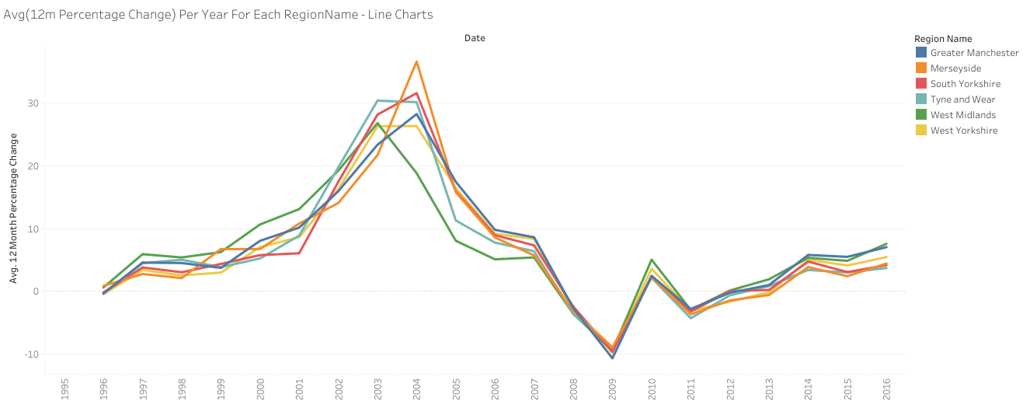

Slide 3
